Slide 1
Welcome to the 10th Annual Meeting of ISMPP!
Leading Through Collaboration

Slide 2
Looking Ahead: ISMPP’s Next Chapter
Al Weigel President/COO, ISMPP

Slide 3
Intention!
The Power of Intention!!!!

Slide 4
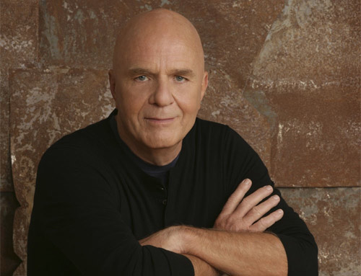
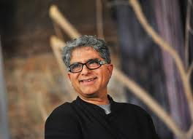
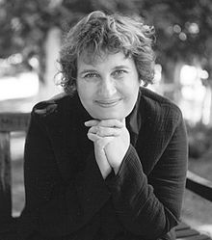
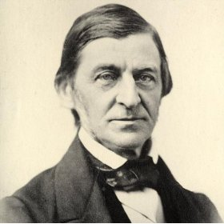
The Power of Intention!

Slide 5
Once you make a decision, the universe conspires to make it happen. - Ralph Waldo Emerson
Each decision we make, each action we take, is born out of an intention. - Sharon Salzberg
Intentions compressed into words enfold magical power. - Deepak Chopra
Our intention creates our reality. - Wayne Dyer

Slide 6
Old Vision
The vision of the ISMPP is to be the recognized and respected authority for the medical publication profession.

Slide 7
New Vision
To become the leading
global
authority
on the
ethical and effective
publication
of medical research to
inform treatment
decisions.

Slide 8
Old Mission
Advance the medical publication profession through education and advocacy
Drive integrity, excellence, and transparency in medical publications
Lead the establishment and adoption of medical publication standards and best practices

Slide 9
New Mission
Advance the medical publication profession globally through:
enhanced integrity and transparency in medical publications
improved standards and best practices
education, advocacy, and professional collaborations

Slide 10
Thank You

Slide 11
Welcome to the 10th Annual Meeting of ISMPP!
Leading Through Collaboration

